Slide 1
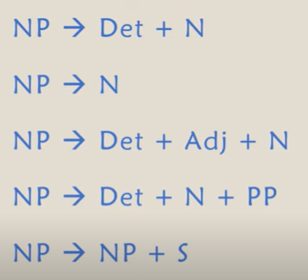
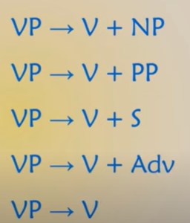
Noun Phrase
Adjective Phrase: AdjP -> Adv + Adj + PP
Eg: quite happy with the result
Adverb Phrase : AdvP - > Deg + Adv
Prepositional Phrase: PP - > Deg + NP
Deg: Degree adverb(optional)
Adj: Adjective
PP : Preposition Phase(optional)
Verb Phrase

Slide 2
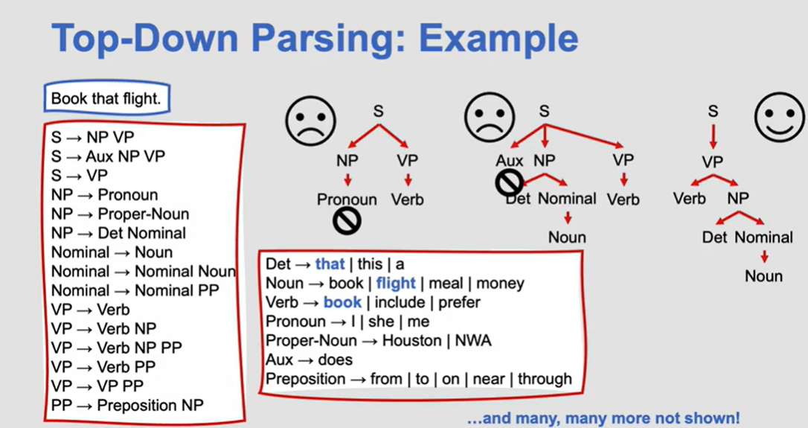
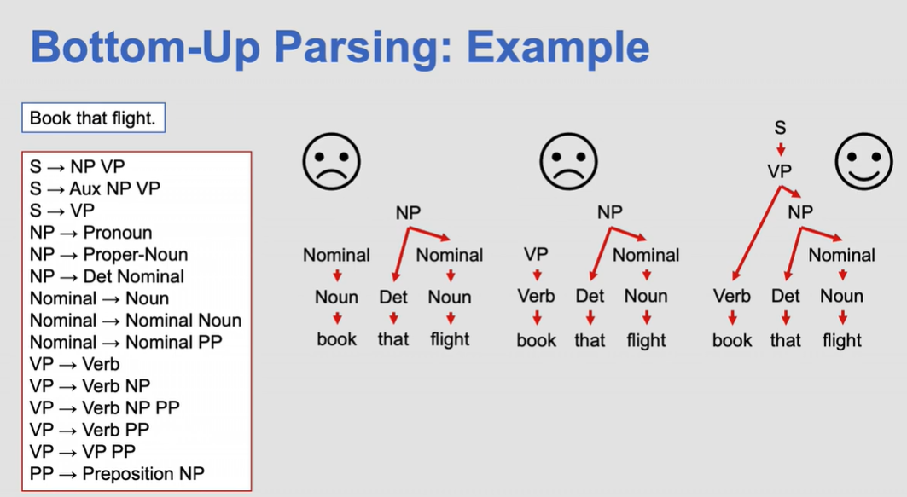
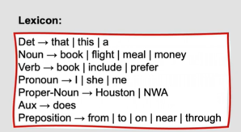

Slide 3
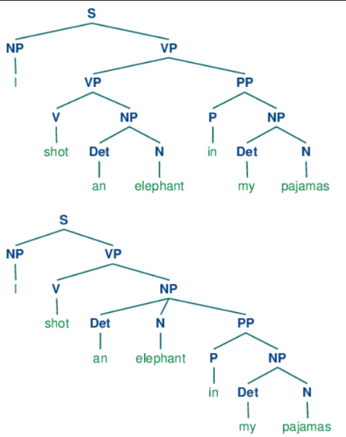
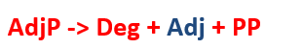

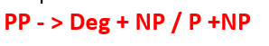
Ambiguity in CFG

Slide 4
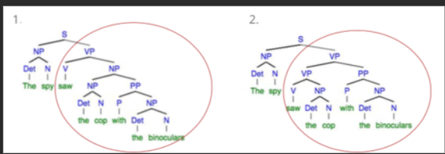
Produce CFG: The spy saw the cop with the binoculars

Slide 5
Probabilistic Context-free Grammars (PCFGs)
Context-free grammars (CFGs)
G = (T, N, S, R)
T is a set of terminal symbols
N is a set of nonterminal symbols
S is the start symbol (S ∈ N)
R is a set of rules/productions of the form X → γ
G = (T, N, S, R, P)
T is a set of terminal symbols
N is a set of nonterminal symbols
S is the start symbol (S ∈ N)
R is a set of rules/productions of the form X → γ
P is a probability function P: R → [0,1]

Slide 6
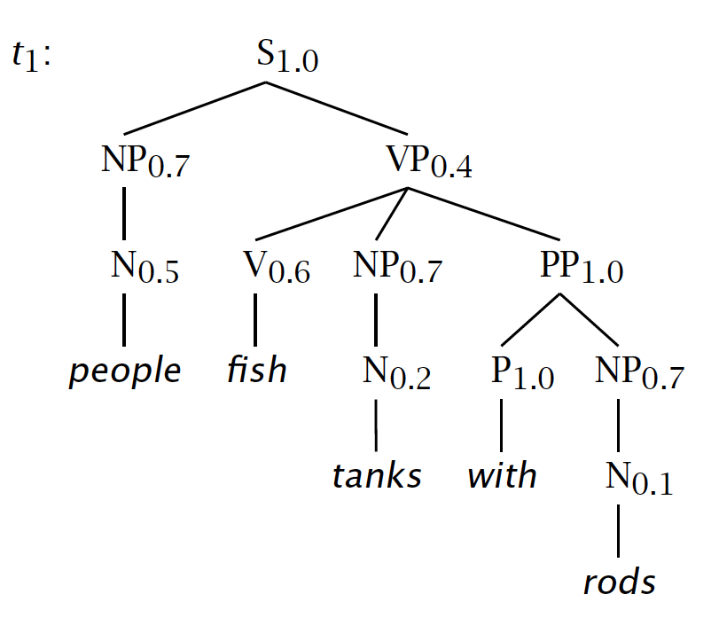
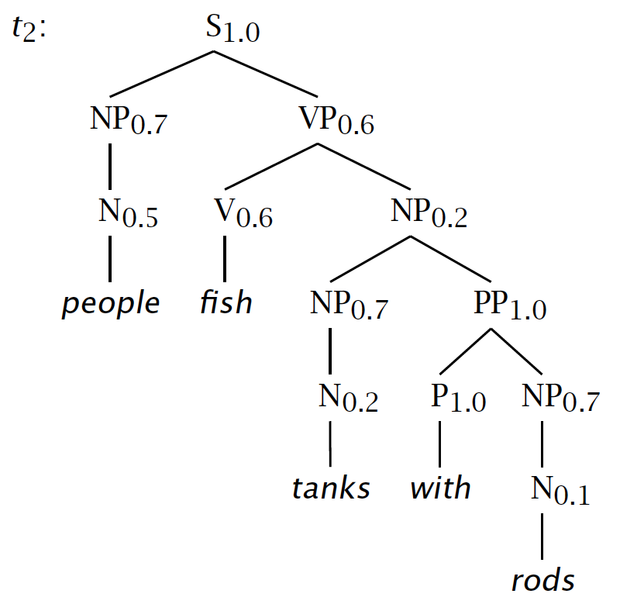
S → NP VP 1.0
VP → V NP 0.6
VP → V NP PP 0.4
NP → NP NP 0.1
NP → NP PP 0.2
NP → N 0.7
PP → P NP 1.0
N → people 0.5
N → fish 0.2
N → tanks 0.2
N → rods 0.1
V → people 0.1
V → fish 0.6
V → tanks 0.3
P → with 1.0
s = people fish tanks with rods
P(t₁) = 1.0 × 0.7 × 0.4 × 0.5 × 0.6 × 0.7 × 1.0 × 0.2 × 1.0 × 0.7 × 0.1 = 0.0008232
P(t₂) = 1.0 × 0.7 × 0.6 × 0.5 × 0.6 × 0.2 × 0.7 × 1.0 × 0.2 × 1.0 × 0.7 × 0.1 = 0.00024696
P(s) = P(t₁) + P(t₂) = 0.0008232 + 0.00024696 = 0.00107016

Slide 7
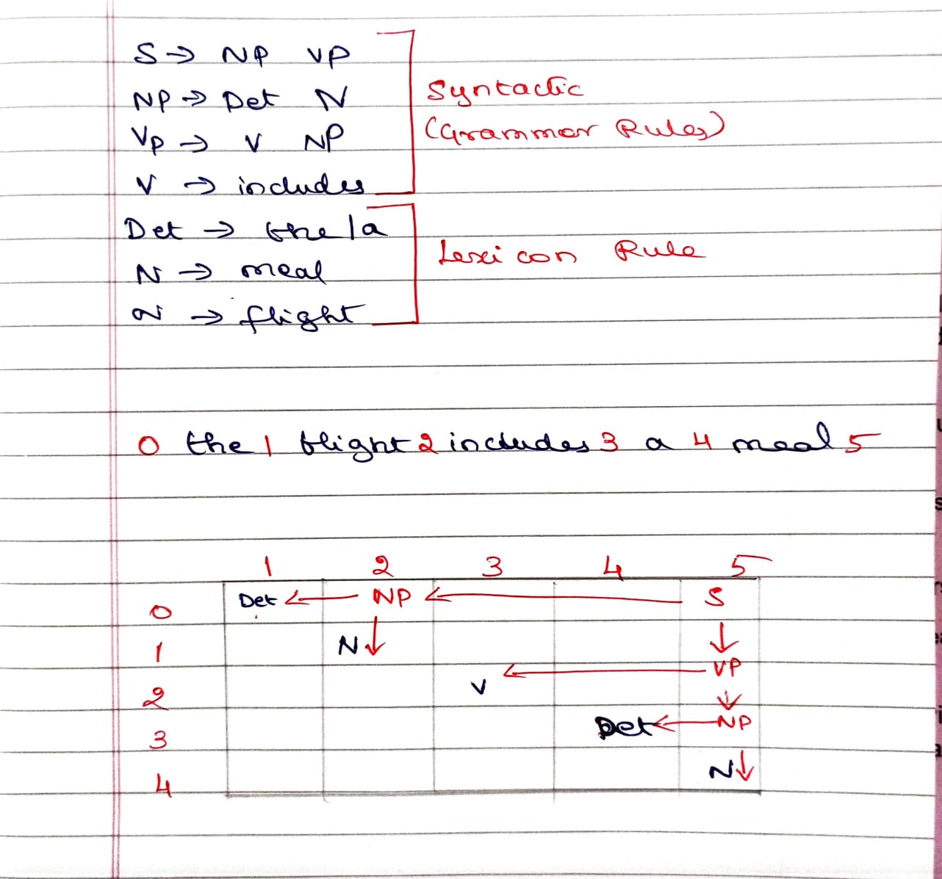
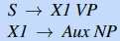
CKY Parsing
CKY parsing can only be done from CNF rules. So convert CFG rules to CNF always. https://youtu.be/6IolsIONBT0?si=IaR2IpYE2I_cu8tf
Grammars in CNF are restricted to rules of the form:
right-hand side of each rule must expand either to two non-terminals: A → B C
right-hand side of each rule must expand a single terminal A → w
CFG
CNF

Slide 8
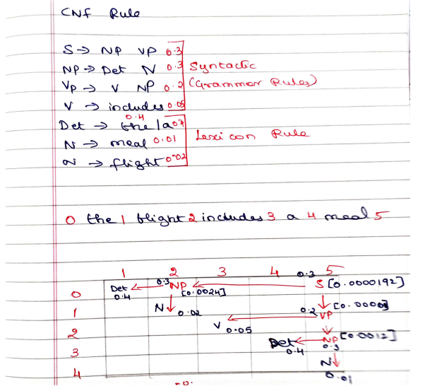
Probabilistic CKY Parsing (0,2) -> NP = 0.4 * 0.02 * 0.3 = 0.0024 (3,5) -> NP = 0.4 * 0.01 * 0.3 = 0.0012 (0,5) -> S = 0.0012 * 0.0024 = 0.0000192

Slide 9
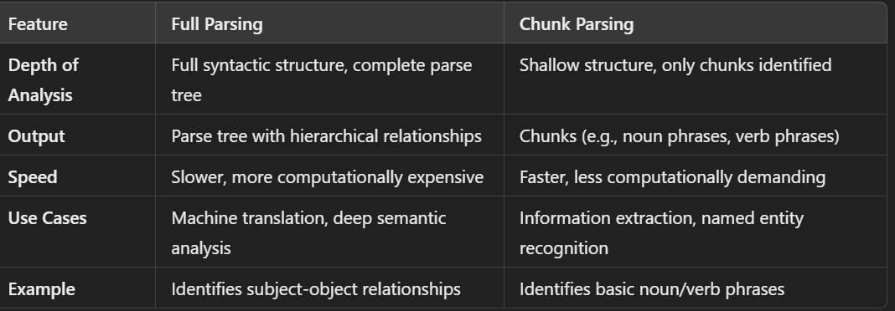
Shallow Parsing
Constituents: [[a tall man] [ in [the park]]].
Chunks:[a tall man] in [the park].

Slide 10
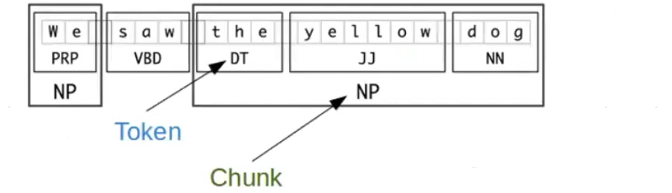
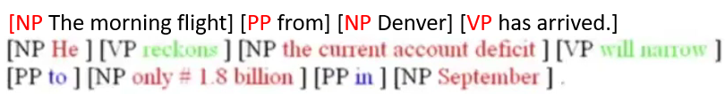
Chunk parsing achieves high accuracy
Small solution space - better locality
No need to resolve ambiguity
Less error propagation
Chunk parsing is less domain specific - Dependencies on lexical/semantic information tend occur at levels “higher” than chunks
Chunks are non-recursive
Regular expression matching:
A simple noun phrase chunk regular expression : <DT> ? <JJ> * <NN.?>
Chunk all matching subsequences:
Input: The /DT little /JJ cat /NN sat /VBD on /IN the /DT mat /NN
Output: [The /DT little /JJ cat /NN] sat /VBD on /IN [the /DT mat /NN]
A chink is a subsequence of the text that is not a chunk.
[the/DT little/JJ cat/NN] sat/VBD on /IN [the /DT mat/NN]
chunk chink chunk

Slide 11
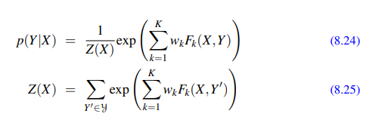
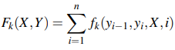
Conditional Random Field
While Hidden Markov Models (HMMs) are powerful for sequence modeling, it is difficult for tasks like capitalization, morphology, or contextual information.
CRFs are used for tasks like sequence labeling, named entity recognition, part-of-speech tagging, and syntactic parsing, where the labeling of each element is dependent on the context of the entire sequence.
A CRF is a log-linear model that assigns a probability to an entire output (tag) sequence Y, out of all possible sequences Y’, given the entire input (word) sequence X.
fk - local features in a linear-chain CRF is allowed to make use of the current output token yi , the previous output token yi−1, the entire input string X (or any subpart of it), and the current position i.

Slide 12
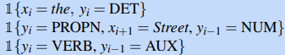
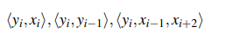
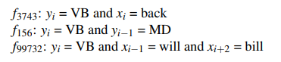
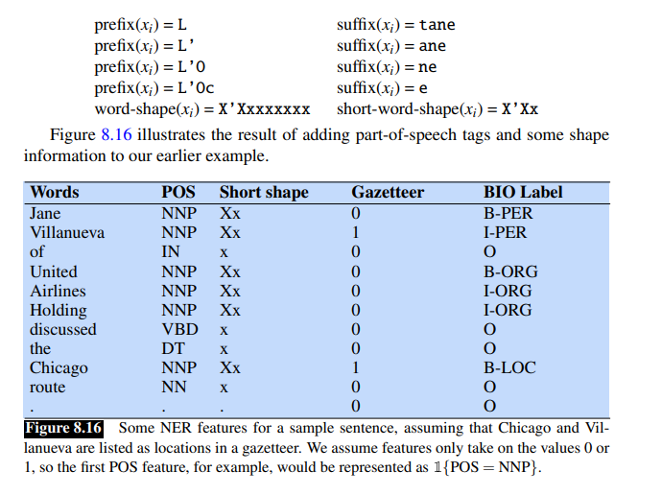
Features in a CRF POS Tagger
All CRF features take on the value 1 or 0
1{x} to mean “1 if x is true, and 0 otherwise”.
Feature Template:
Janet/NNP will/MD back/VB the/DT bill/NN
xi is the word back, the following features would be generated and have the value 1
word shape features: which represent the abstract letter pattern of the word by mapping lower-case letters to ‘x’, upper-case to ‘X’, numbers to ’d’, and retaining punctuation.
Ex: I.M.F maps to X.X.X. DC10-30 maps to XXdd-dd
The sample named entity token L’Occitane would generate the following nonzero valued feature values

Slide 13
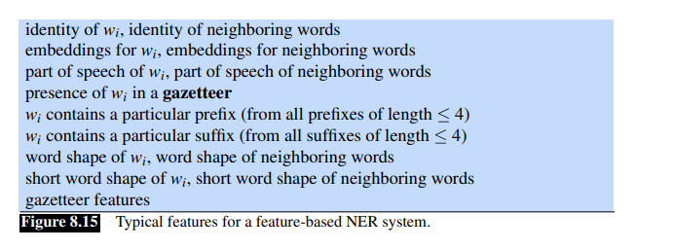
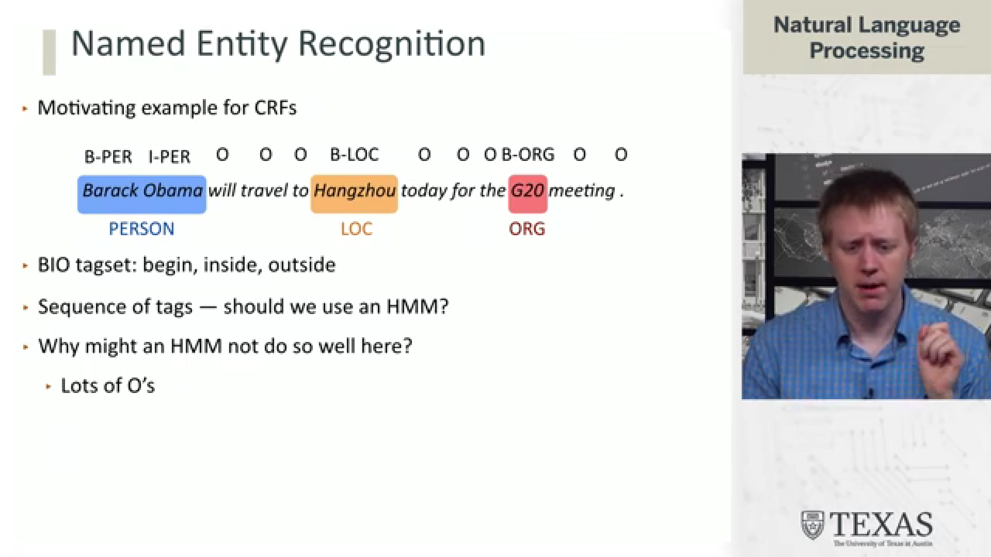
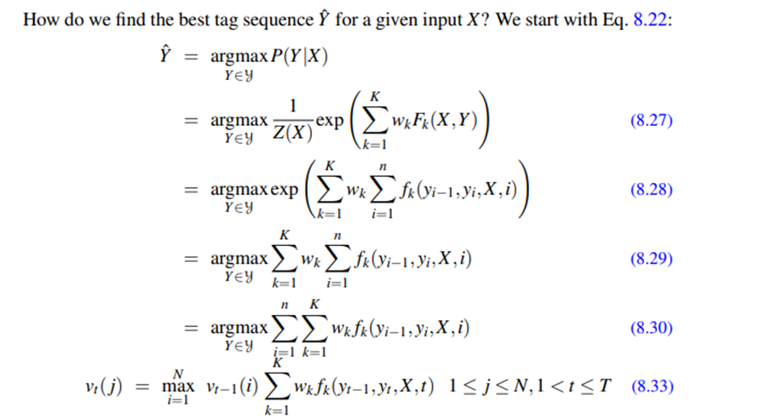
Features for CRF Named Entity Recognizers
https://youtu.be/3w0EhxiebUA?si=cOG9_YHhlFLTDPWQ

Slide 14
Dependency Parsing – Dependency relations
nsubj: nominal subject -
The noun that performs the action of the verb.
Example: In "She sings," She is the subject of the verb sings.
dobj: direct object -
The noun that directly receives the action of the verb.
Example: In "She sings a song," song is the direct object of the verb sings.
iobj: inditect object -
Refers to the noun that indirectly receives the action, typically a recipient.
Example: In "He gave her a gift," her is the indirect object receiving the direct object gift.
“She gave me a raise” iobj(gave, me)
ccomp: clausal complement -
A clause that serves as the object of a verb/adjective, often introduced by "that" or other complementizers.
In "She said that she will come," the clause that she will come is the clausal complement of said.
He says that you like to swim ccomp(says, like)
xcomp: open clausal complement -
A clausal complement that does not have its own subject and shares the subject with the main verb.
In "She wants to sing," to sing is the open clausal complement of wants.
eg: He says that you like to swim” xcomp(like, swim)

Slide 15
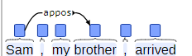
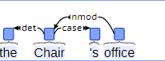
nmod: nominal modifier
A noun that modifies another noun, providing additional information like possession, location, etc.
In "the roof of the house," house is a nominal modifier of roof.
amod: adjectival modifier
An adjective that modifies a noun.
In "a red car," red is an adjectival modifier of car.
nummod: numeric modifier
A number that modifies a noun to specify quantity or order.
In "three apples," three is the numeric modifier of apples.
appos: appositional modifier
A noun or noun phrase that directly follows another noun and provides additional information or clarification.
In "My friend, John, is here," John is an appositional modifier of friend.
case: case marking
Prepositions, postpositions, or other markers that indicate the grammatical function of a noun phrase.
In "on the table," on is the case marker (preposition) indicating the relationship of table.

Slide 16
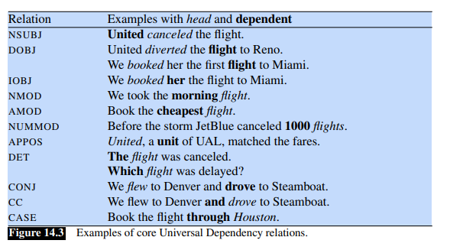
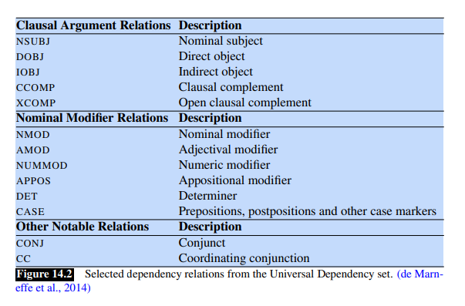
conj: conjunct -
Refers to elements that are connected by a conjunction (words, phrases, or clauses).
In "apples and oranges," apples and oranges are conjuncts.
Eg: “Bill is big and honest” conj(big, honest)
cc: coordination -
The conjunction that connects words, phrases, or clauses of equal syntactic importance.
In "He ate and drank," and is the coordinating conjunction connecting ate and drank.
aux: auxiliary
An auxiliary of a clause is a non-main verb of the clause, e.g., a modal auxiliary, or a form of “be”, “do” or “have” in a periphrastic tense.
Reagan has died aux (has, died)

Slide 17
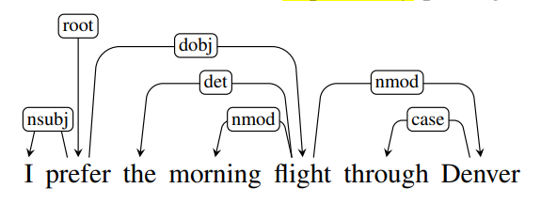
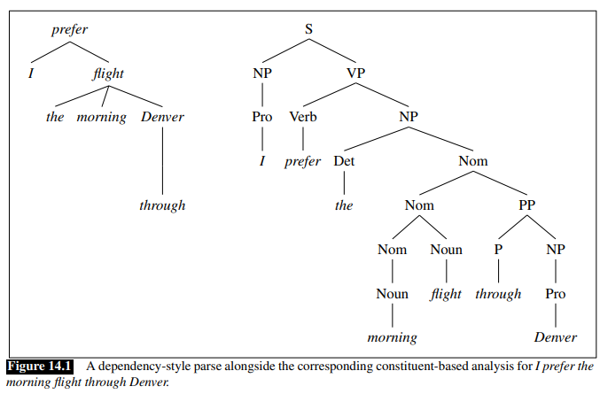
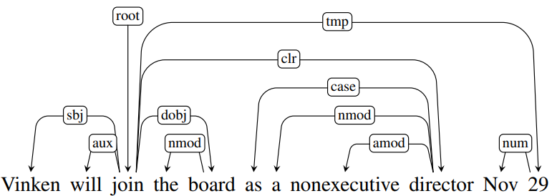
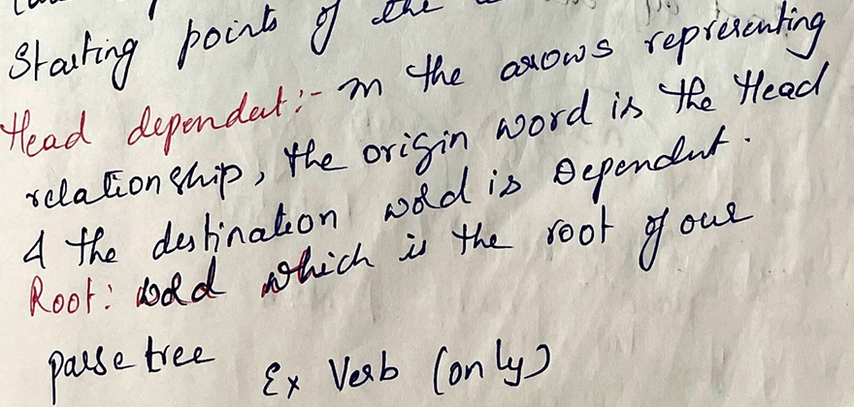
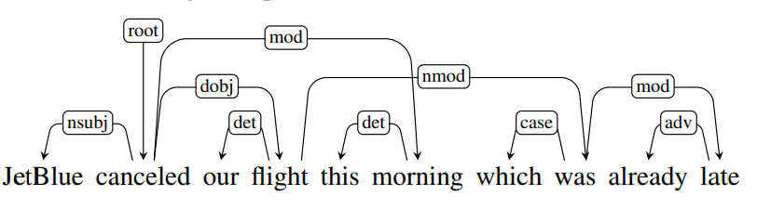

Parsing tree

Slide 18
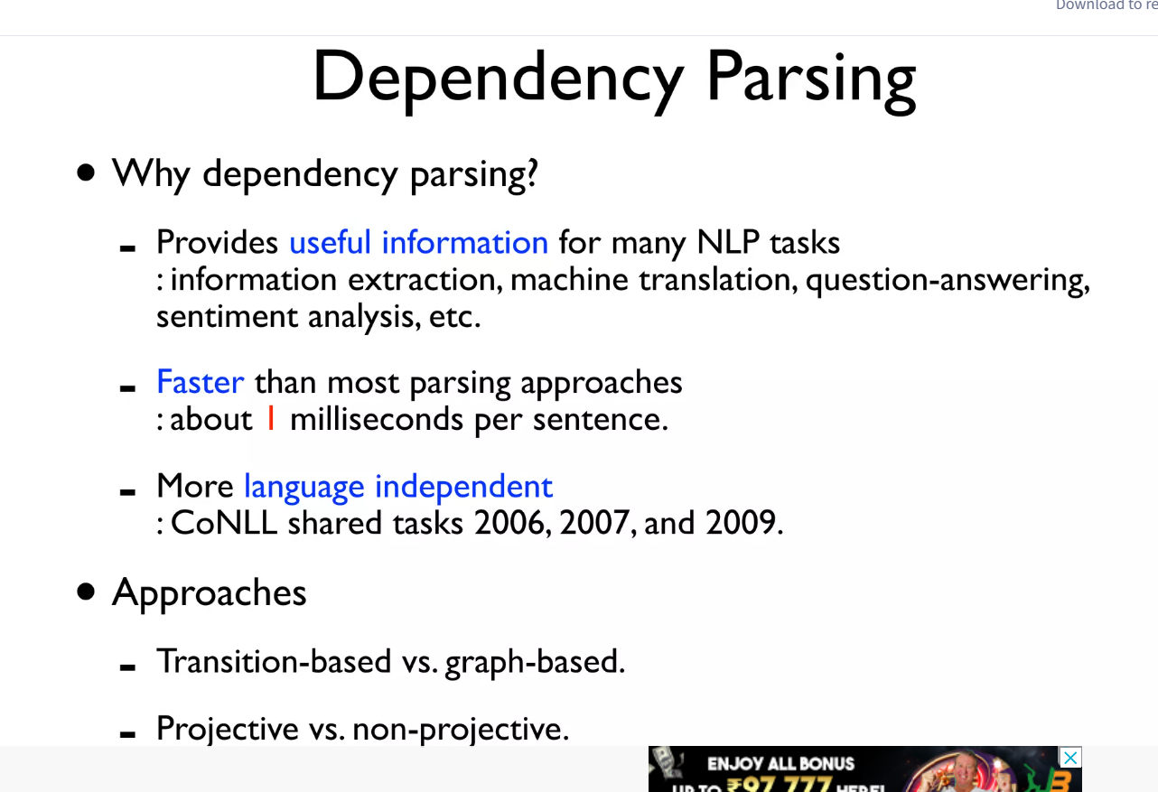
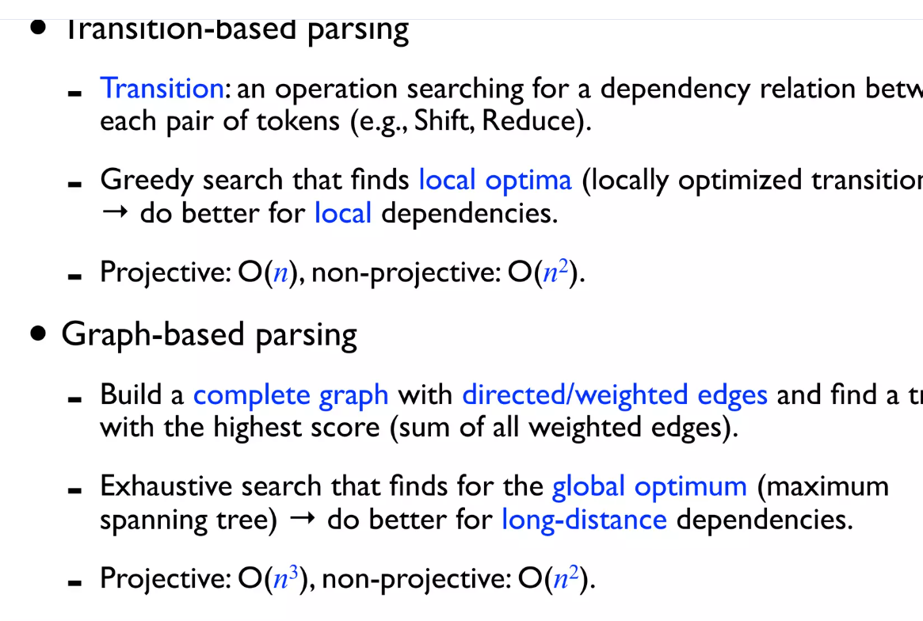

Slide 19
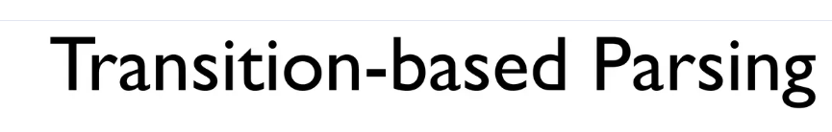
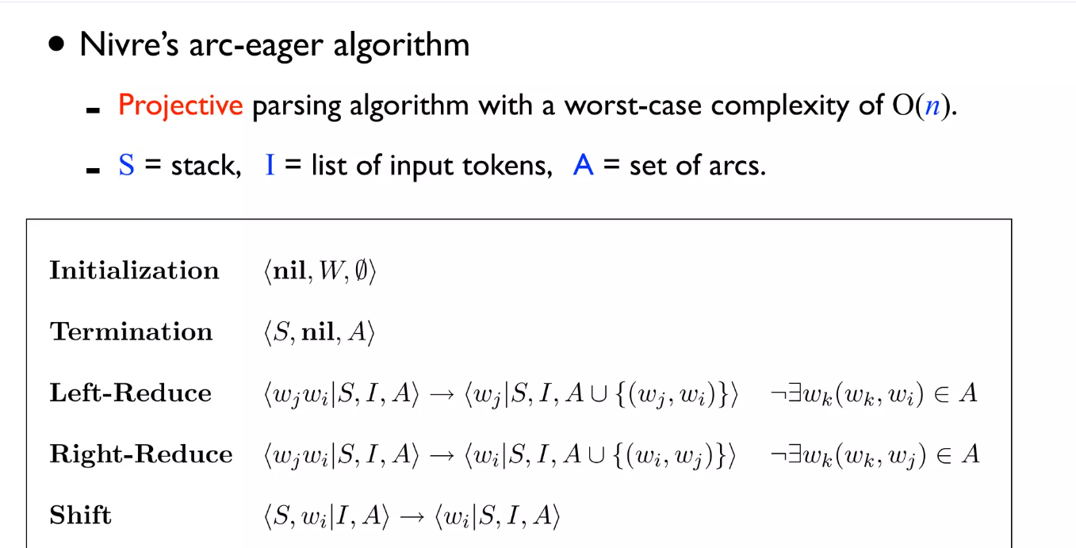
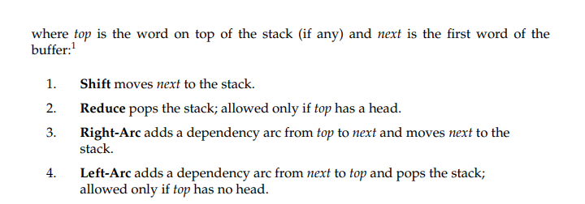

There are four possible transitions from a configuration

Slide 20
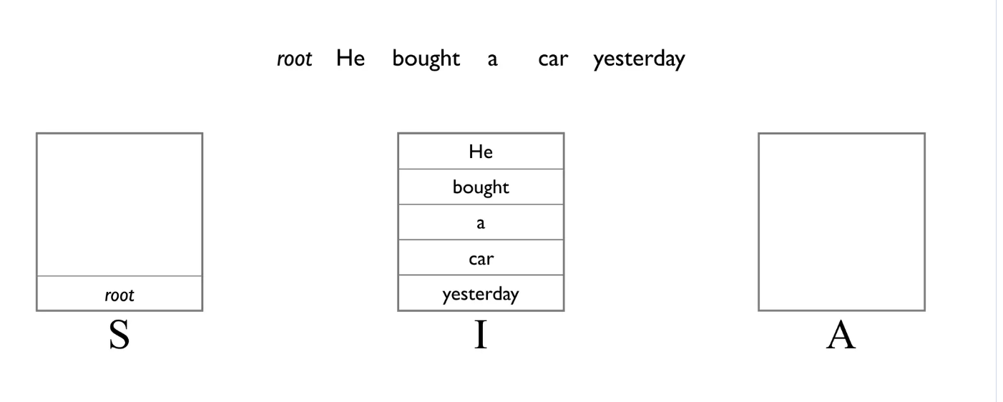
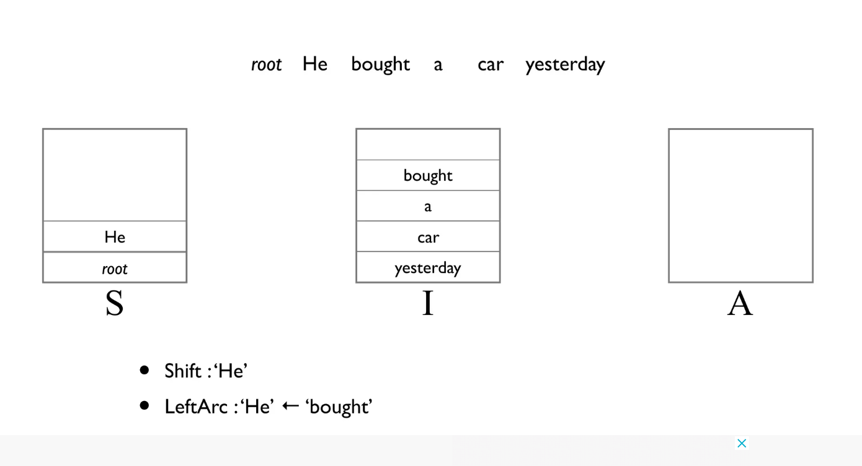
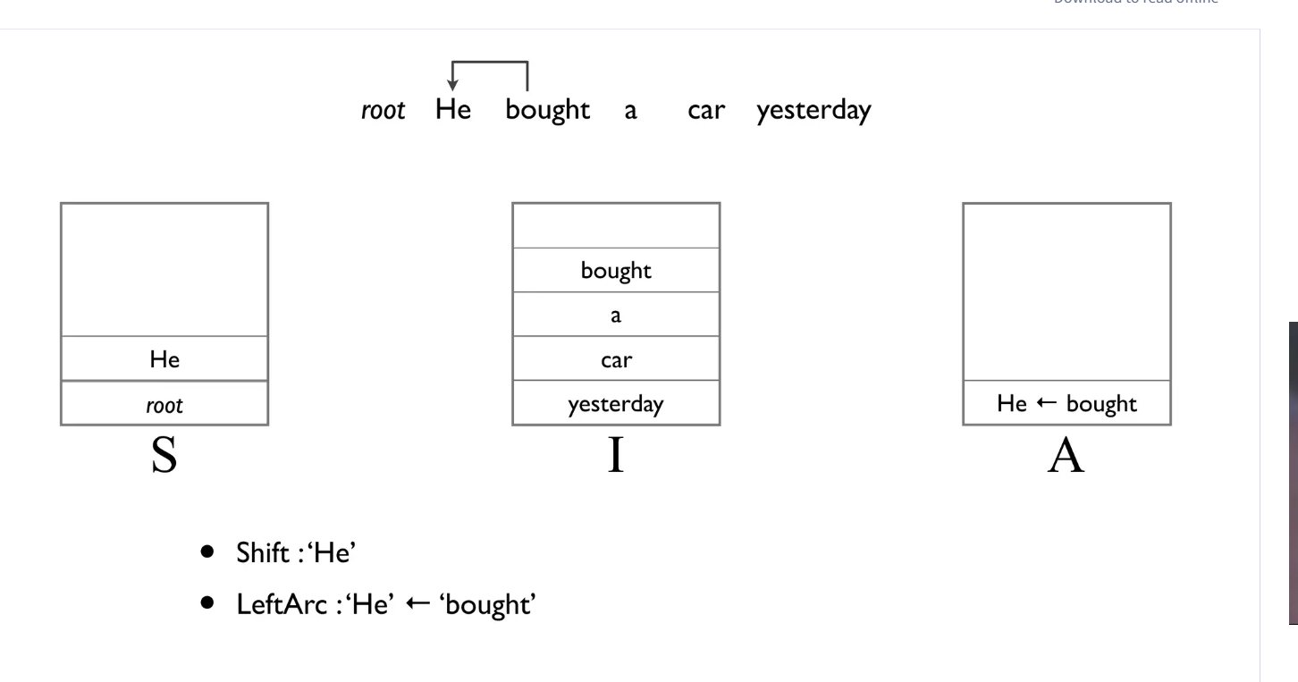
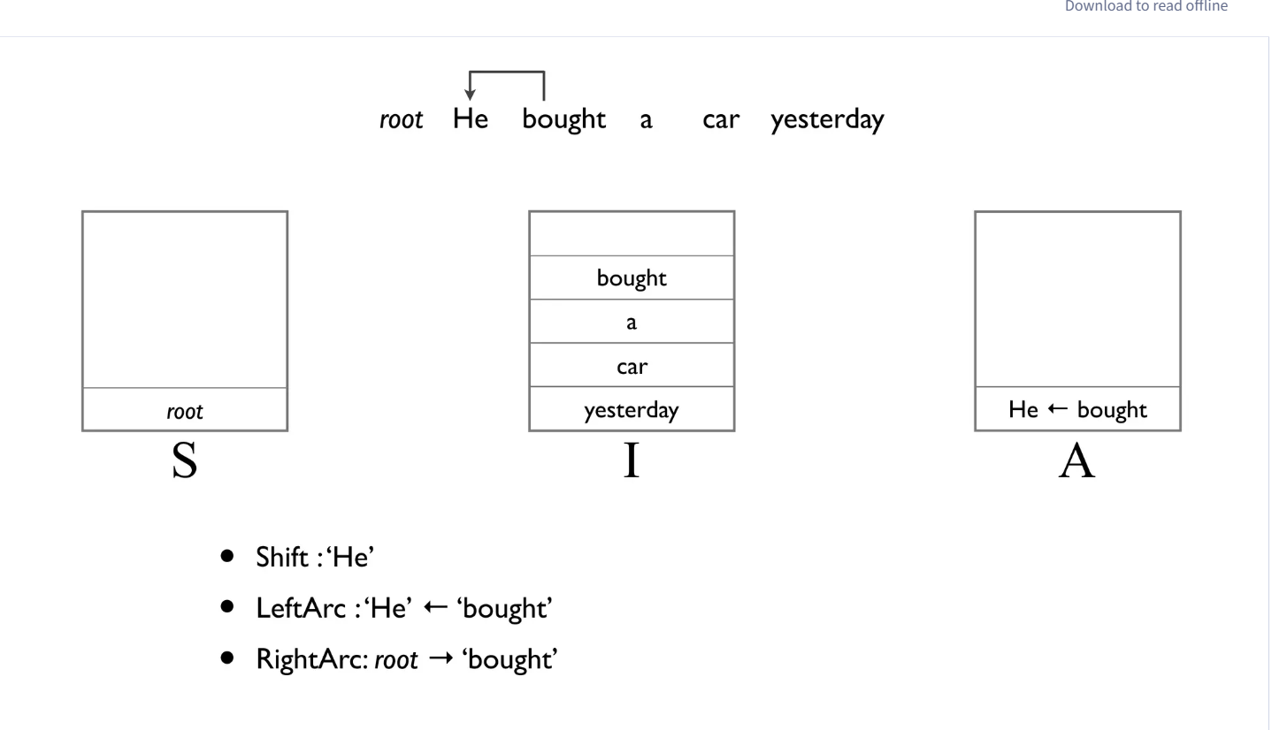
Left arc parallelly pops top (He) from stack because it does not have a head yet.
It will develop a head after completion of left – arc step.

Slide 21
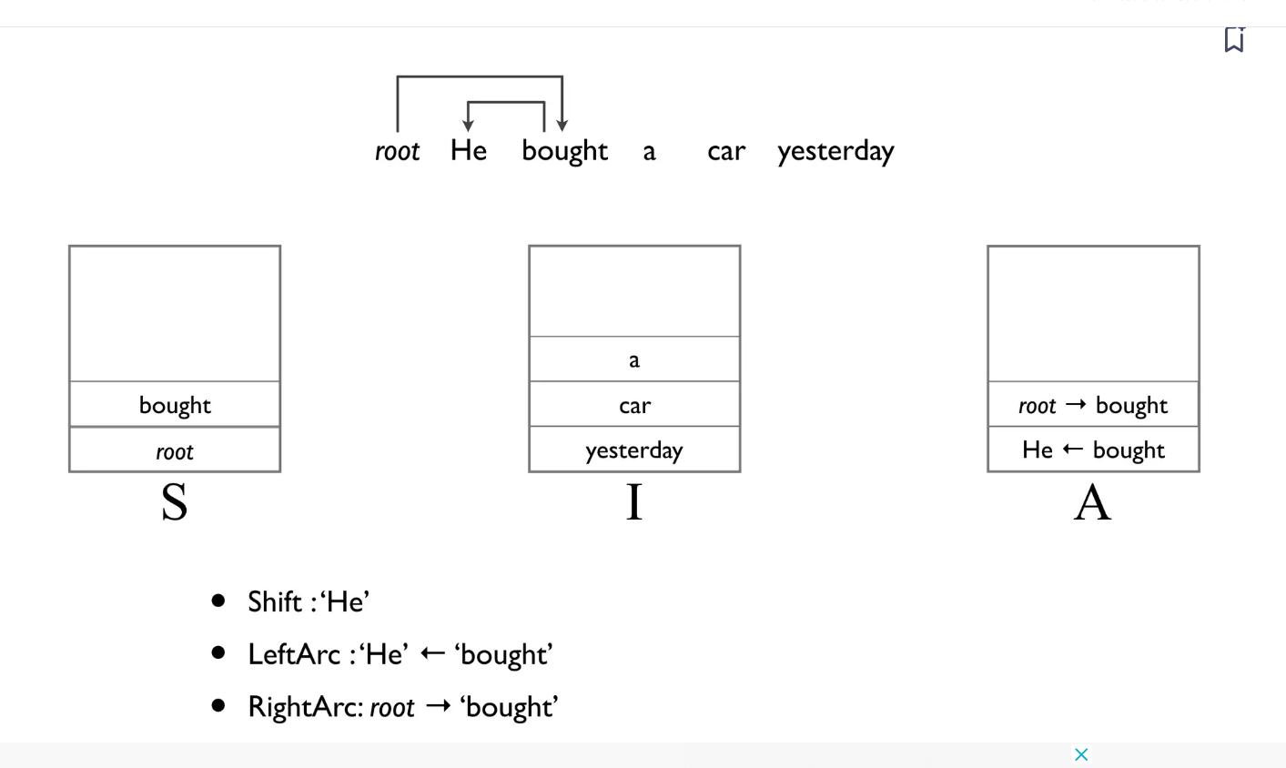
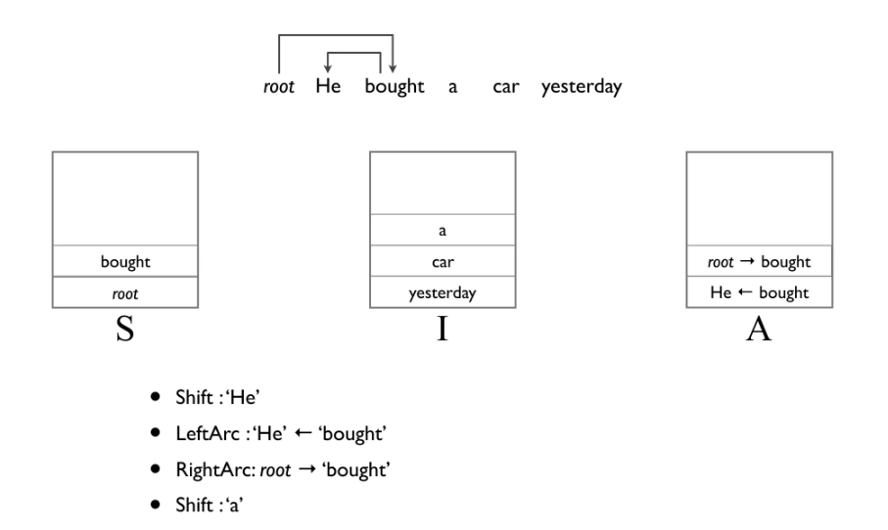
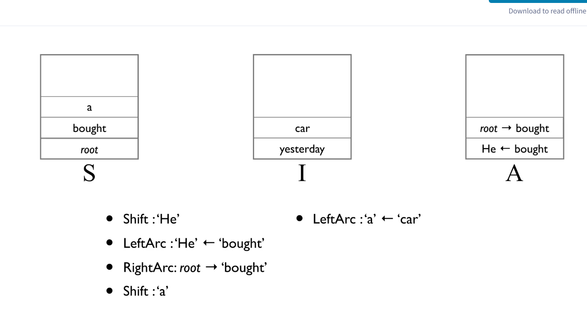
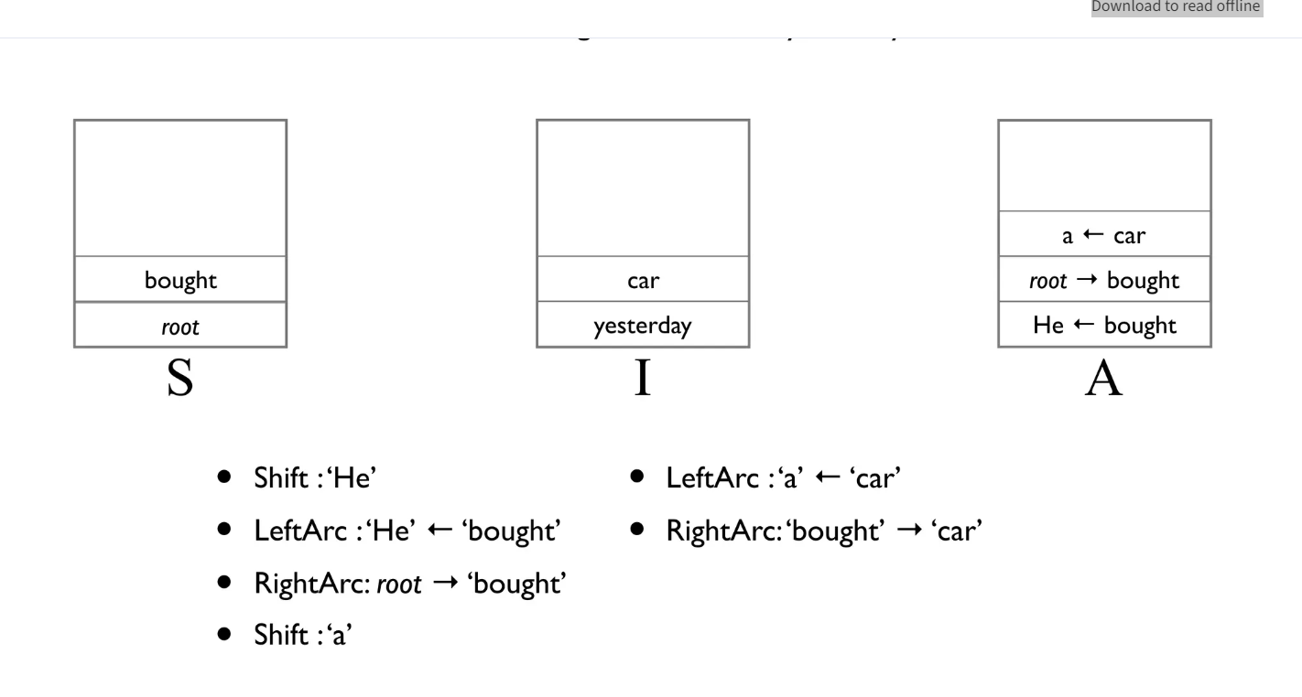
Right-arc pushes next into stack
No change so shift next

Slide 22
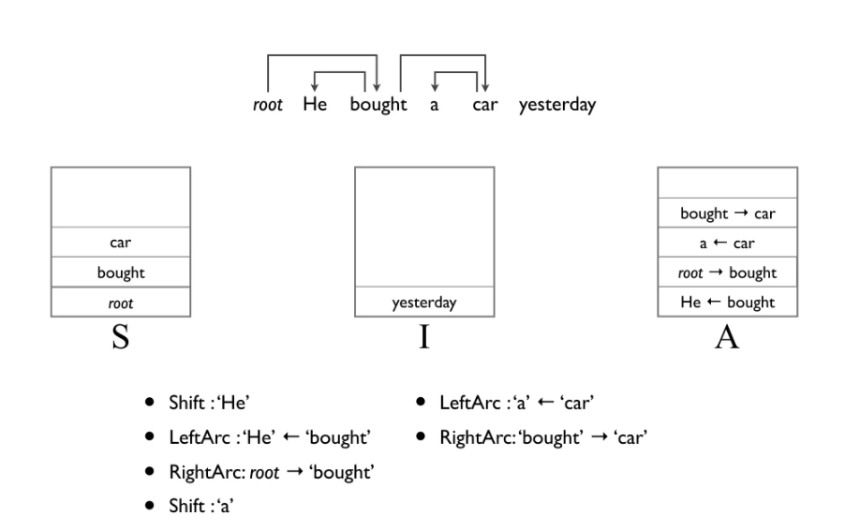
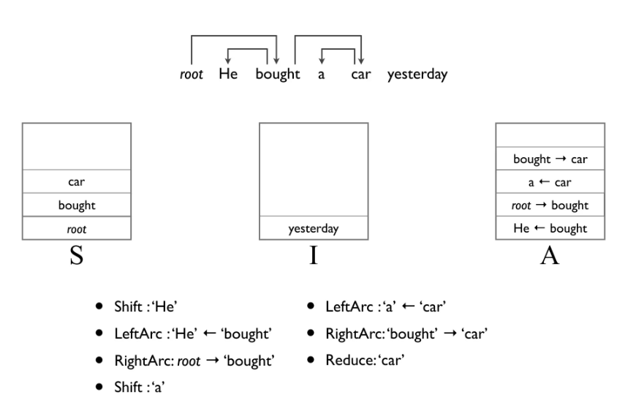


Pop car because it developed a head in the prev step due to right-arc

Slide 23


Reduce bought as it has head

Slide 24

https://youtu.be/LuOpvzRqbUI?si=c6gAuf_lwCz0bwBU
Select max values to each node (cuz Greedy approach)
Subtract max value of each node with weight of incoming edges
Eliminate cycle cause only by blue lines by merging two nodes
No more cycle now (only consider max values i.e blue lines)
Why delete this particular edge? Because flight already has an incoming edge for Book and nodes are allowed to have only one incoming edge)
Expand nodes back to original and delete cycle

